Slide 1
[ Name: Saunak Mukherjee] [Institution: DataTrained] [Flip Robo Technology]
CARS: PRICE PREDICTION

Slide 2
ABSTRACT
A car price prediction which is the very high interest research area that is requires to high effort and knowledge of the field expert.
To build a model for predicting the used cars prices here we applied Linear Regression technique.
Respective performance of different algorithms we are compared to find the best suits of available dataset,
Lastly the model was evaluated using test data and we got the accuracy of 99% obtained

Slide 3
INTRODUCTION
Car Price Prediction especially used when the Car is come direct to the factory or the car is not used. There is price prediction or many mechanism for all used cars.We use “https://www.cars.com/shopping/results/?stock_type=used&makes%5B%5D=&models%5B%5D=&list_price_max=&maximum_distance=all&zip=“ this website to predict the cars price. We have scrapped many data like bmw, audi, Hundai and many more cars.

Slide 4
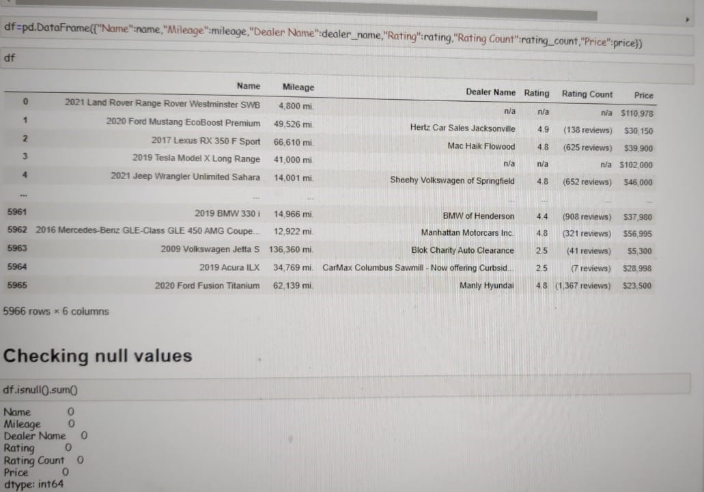
DATASET OVERVIEW
The dataset initially has 5966 rows and 6 columns,
The 6 features are Name,Mileage,Rating and RatingCount and Price is the target column we have to predict the Price.
No null values are present in the dataset.

Slide 5
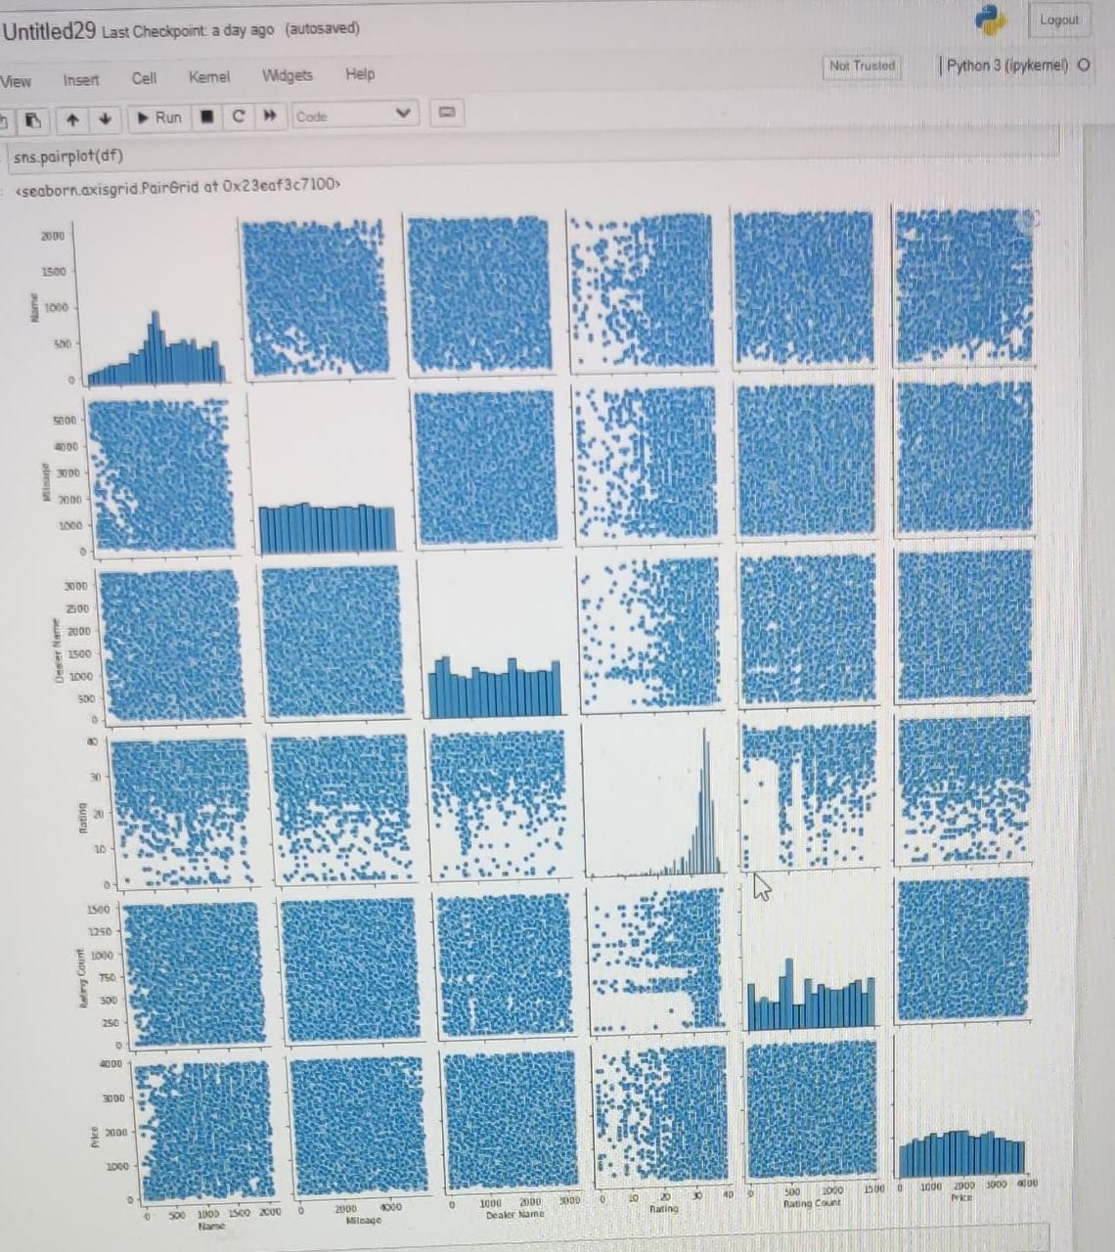
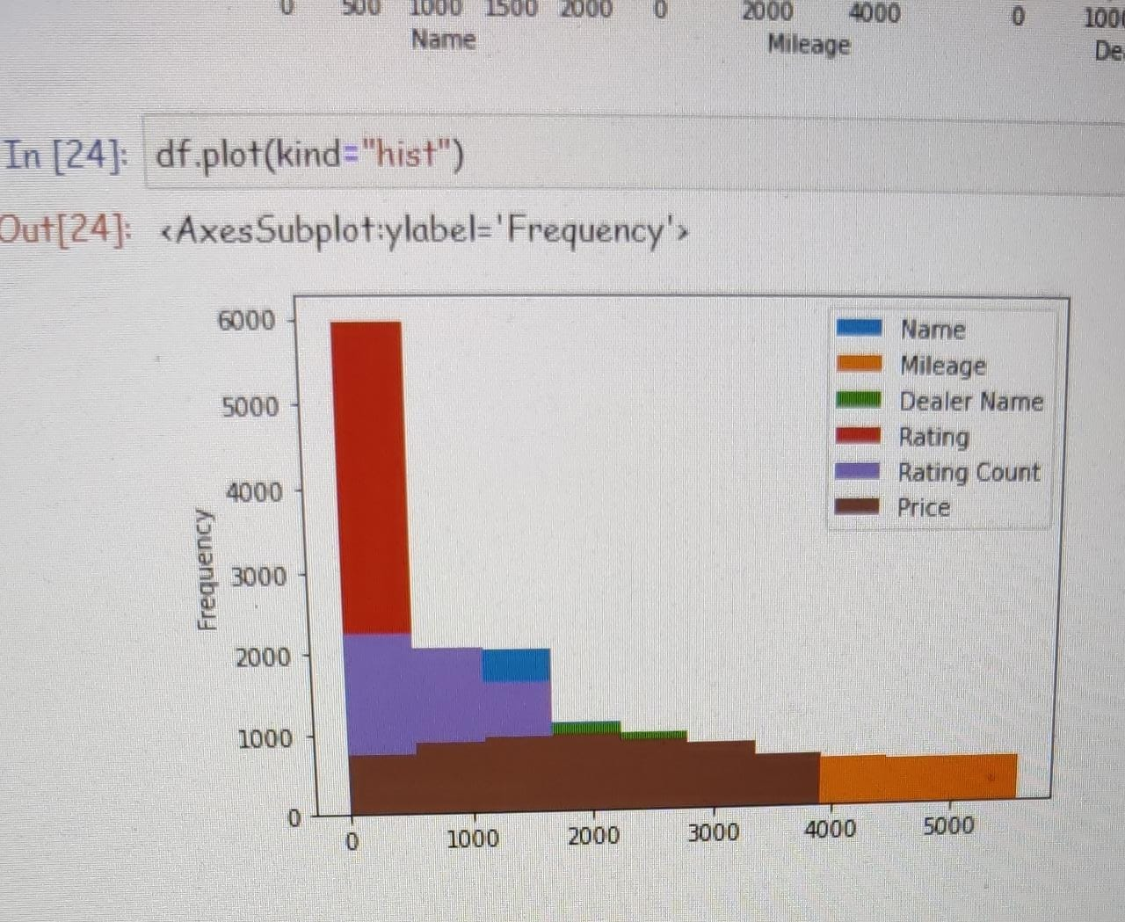
WE ALSO PLOT PAIR PLOT AND HIST PLOT
.

Slide 6
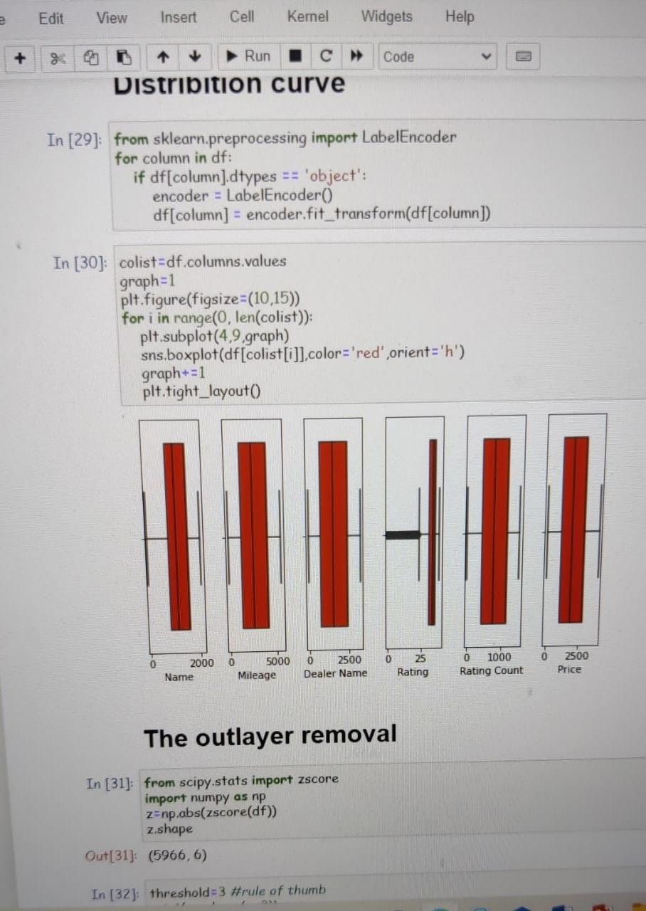
nORMAL DISTRIBUTION
We checked the data is normally distributed or not and we have also seen some outlayers are present and we renoved the outlayer and 2.65% data has been removed

Slide 7
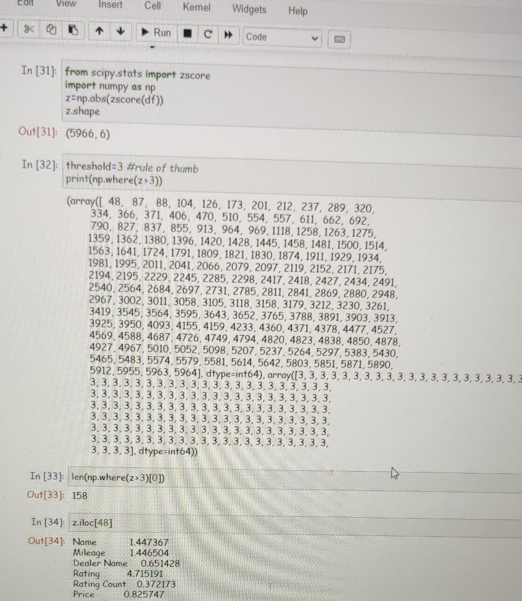
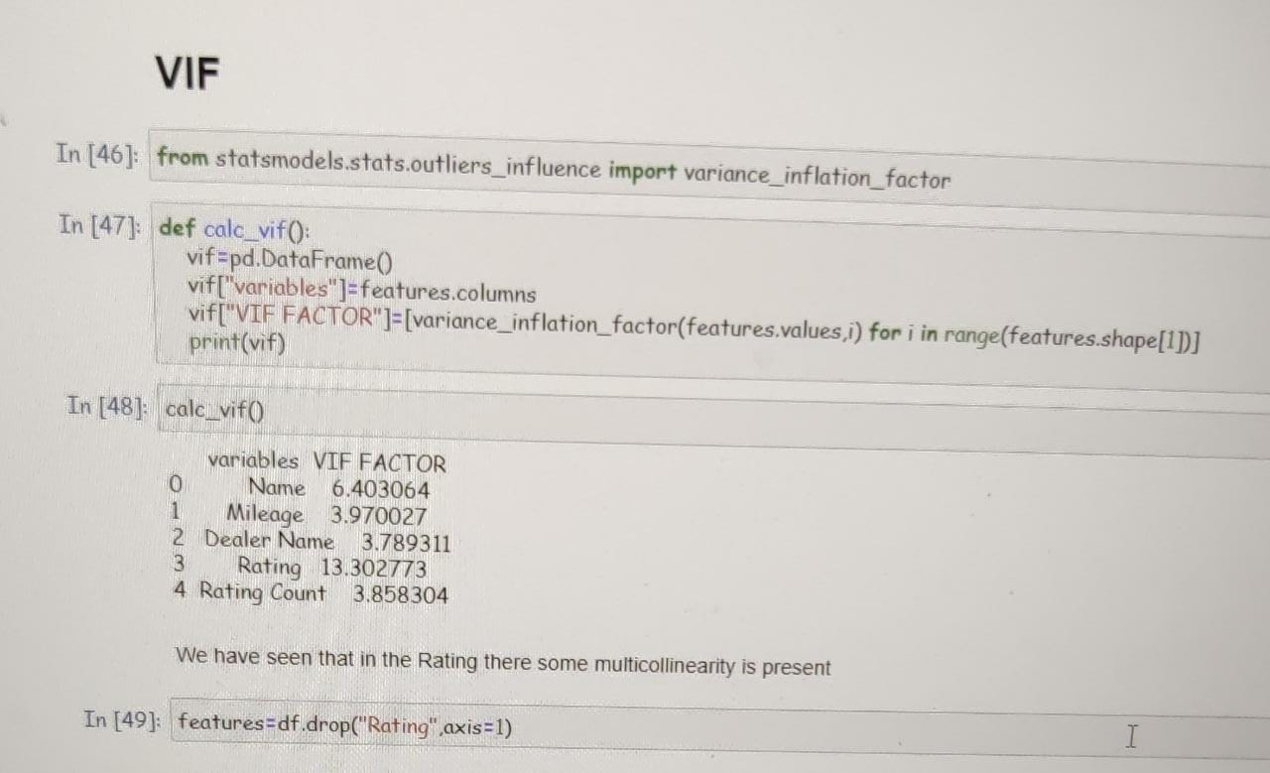
DATA CLEANING
We also did Z-Score method to remove the skewness of the model.We have also used VIF to remove the multicollenearity of the data

Slide 8
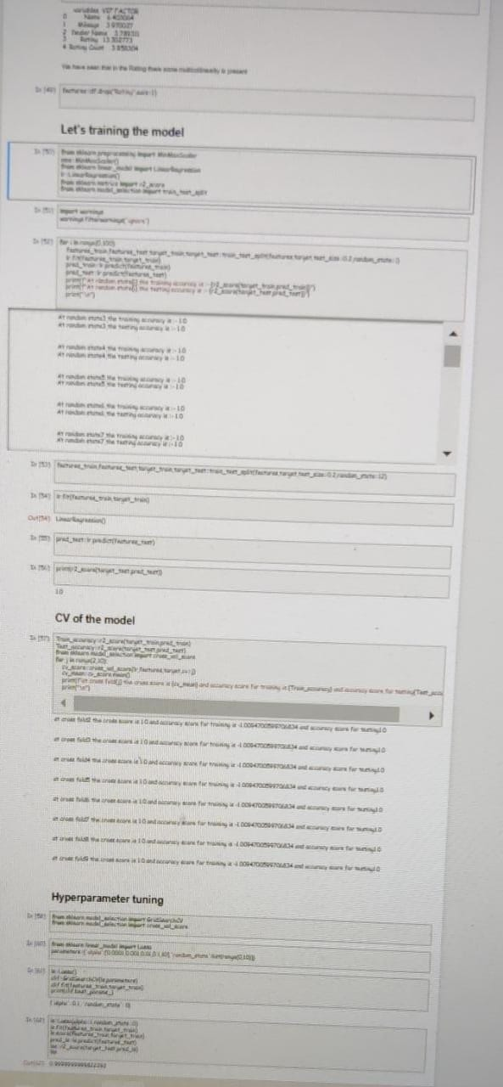
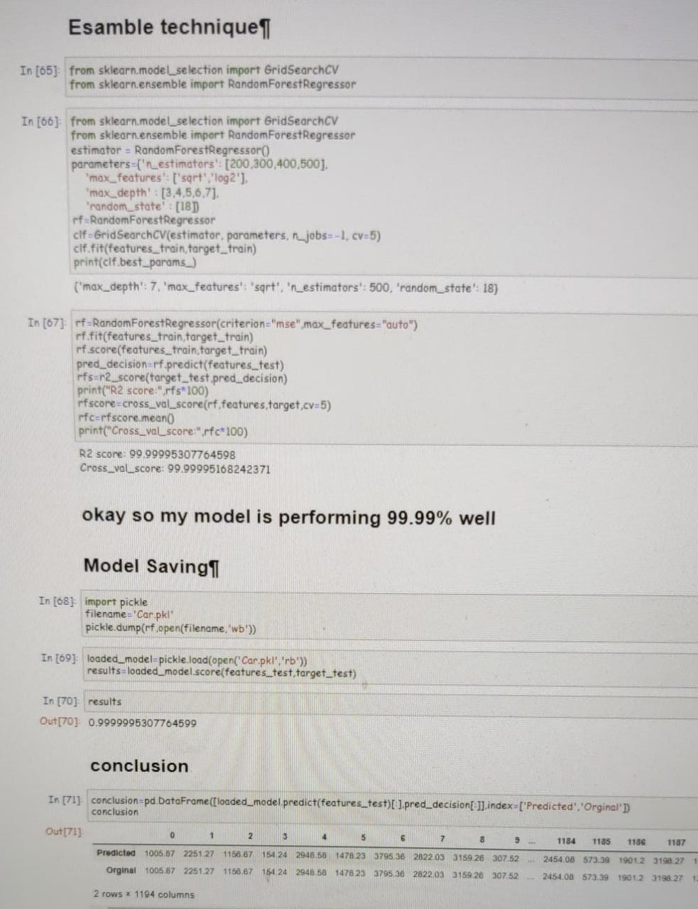
MODEL BUILDING
We used linearoritham beacause the target column is continues.
We used minmax scaler, R2 score, train_test_split to train the model
We have also used Cross validation and hyperparametertunig and we also get 99.99% accuracy.

Slide 9
ONE HOT ENCODING
This technique is used to covert the categorical variables into numeric values.
we have used one hot encoding method which is convert them as numeric values

Slide 10
RESULTS AND OUTPUT
We created a function which is predict car price.
our function is to “car_predict_price”
We pass the values into our function and it will predict.
We got the accuracy 99.99% of the model

Slide 11
THANK YOU

